Slide 1
Release 11.4 and 11.5
Client Training- Published 12/13/11

Slide 2
Concentration Risk Analysis

Slide 3
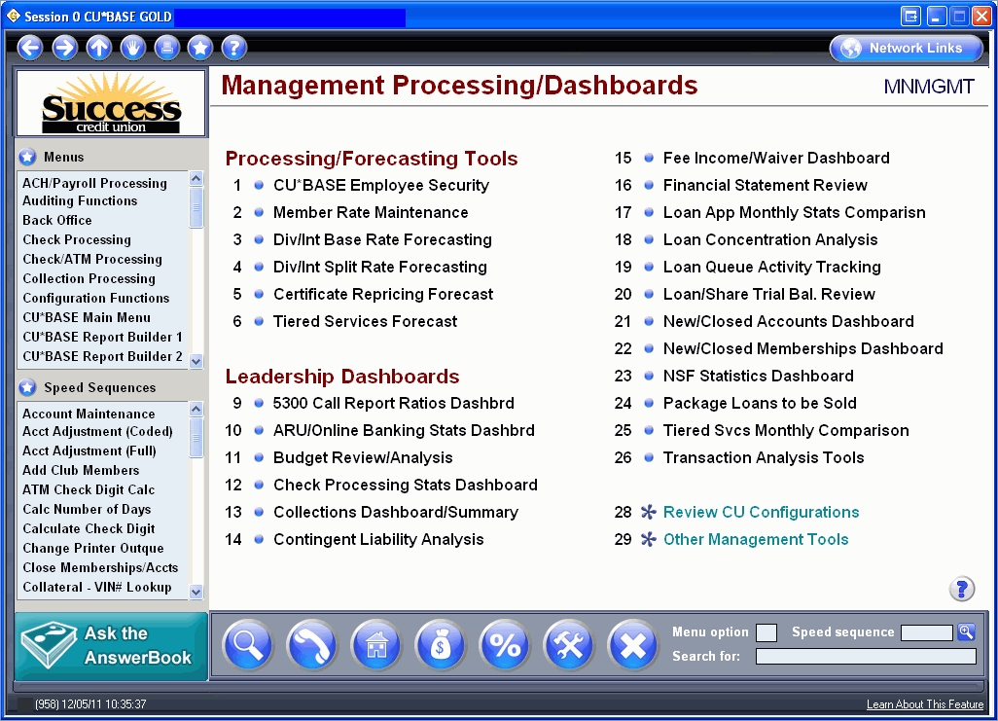

Slide 4
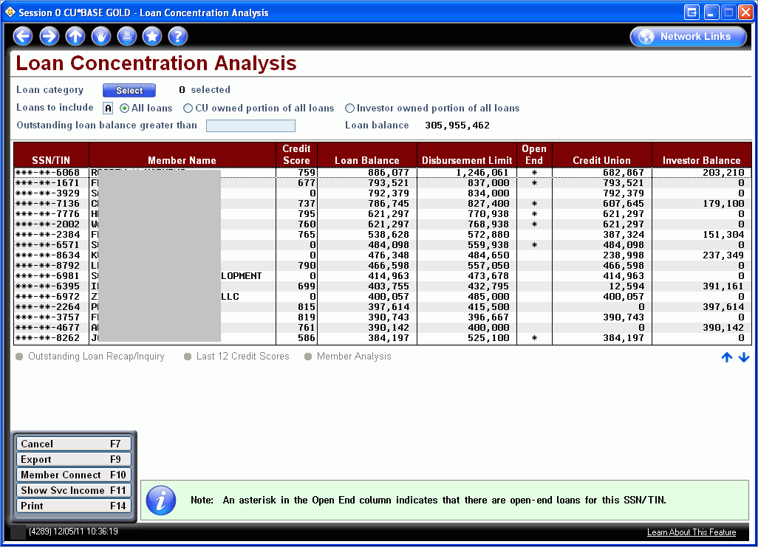

Slide 5
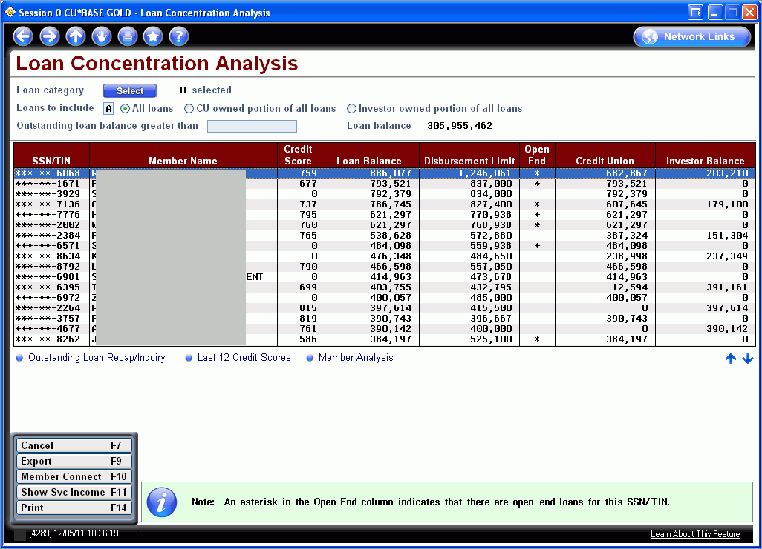

Slide 6
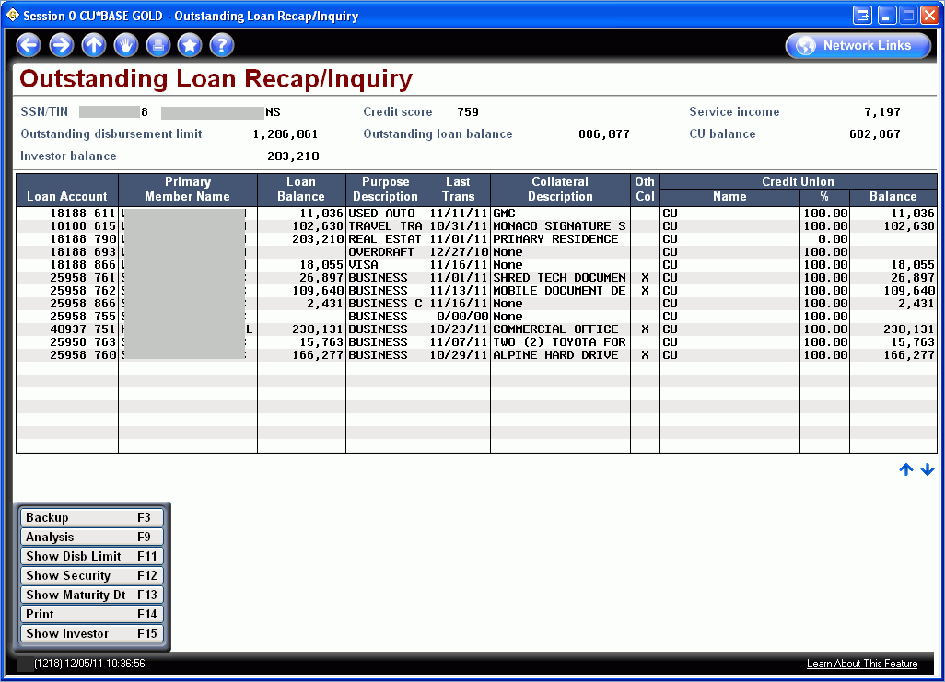

Slide 7
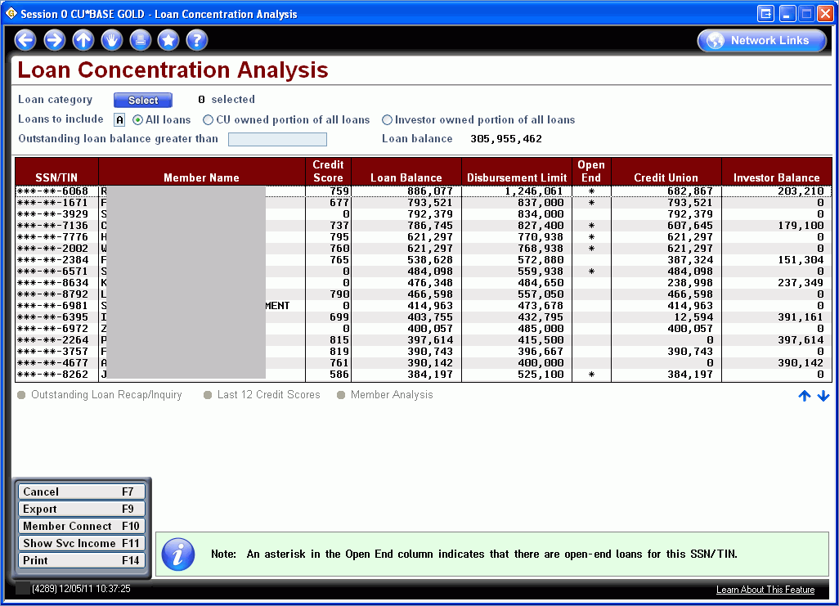

Slide 9
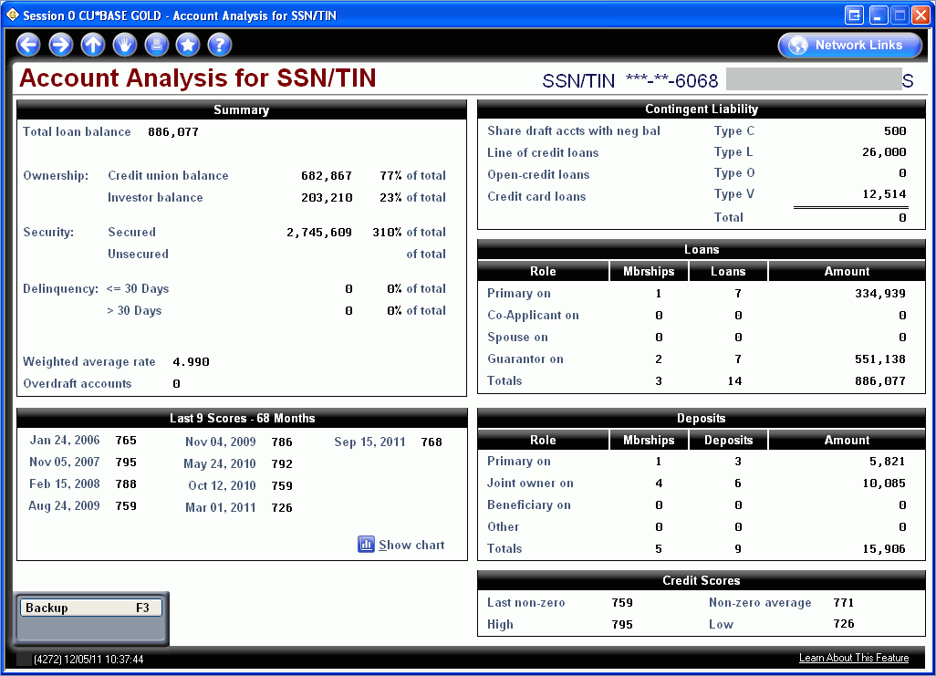

Slide 10
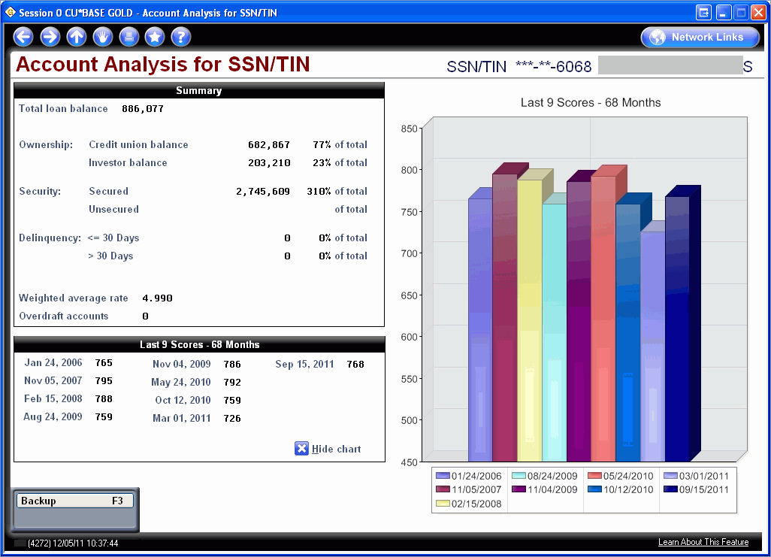

Slide 11
Packaging Loans for Sale

Slide 13
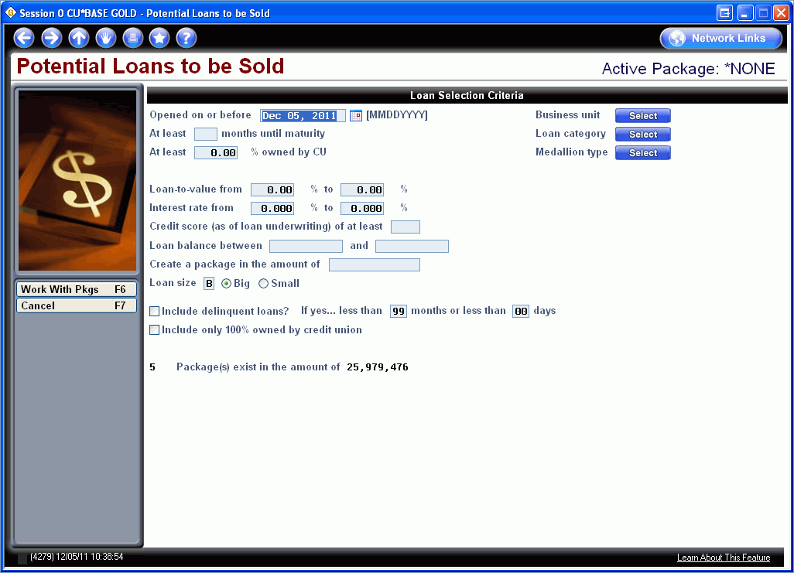

Slide 14
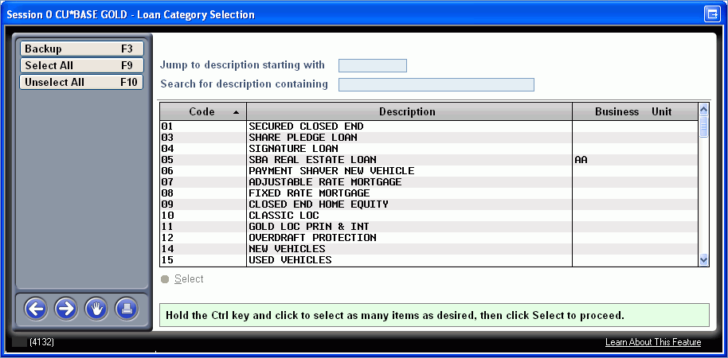

Slide 15
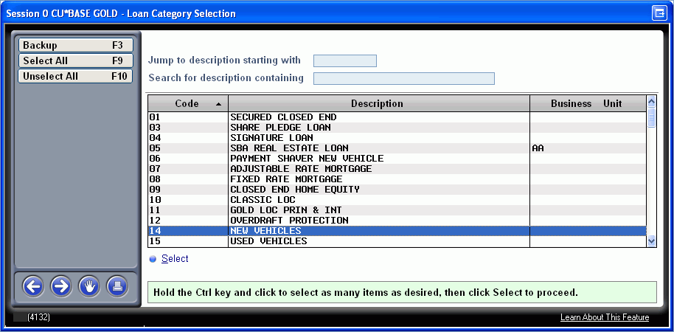

Slide 16
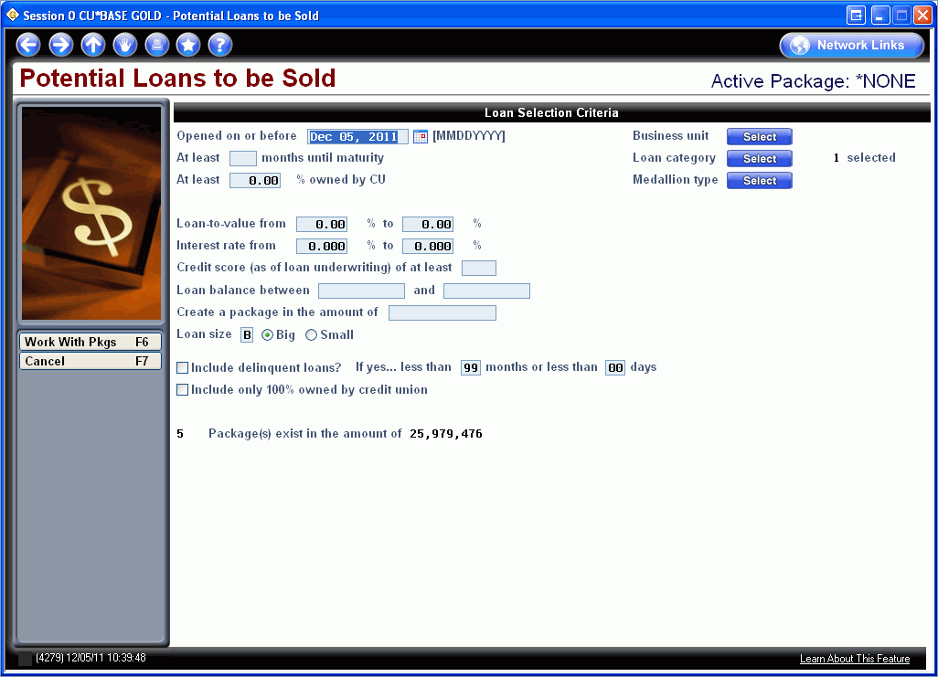

Slide 17
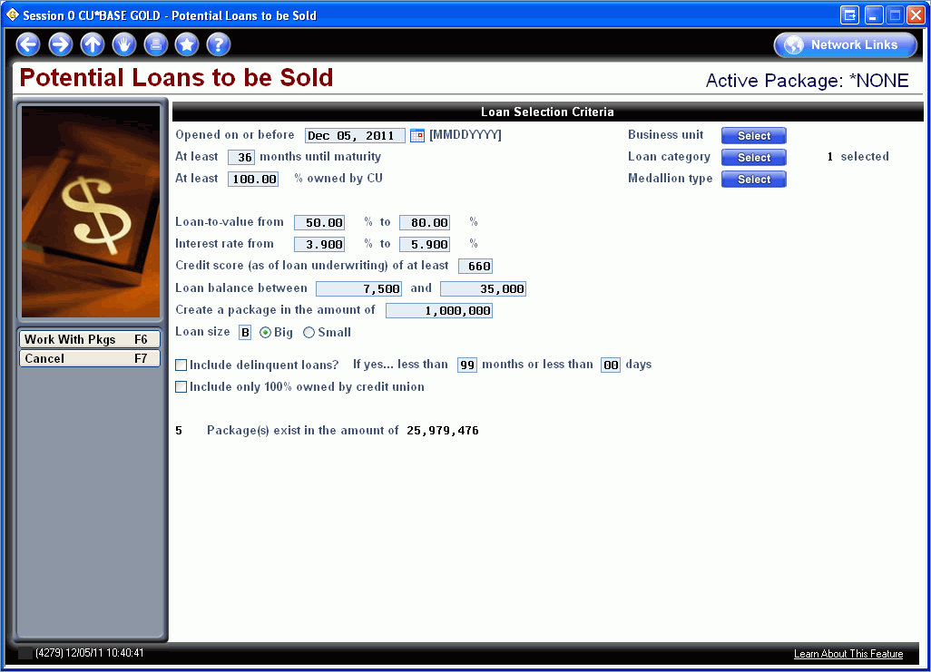

Slide 18
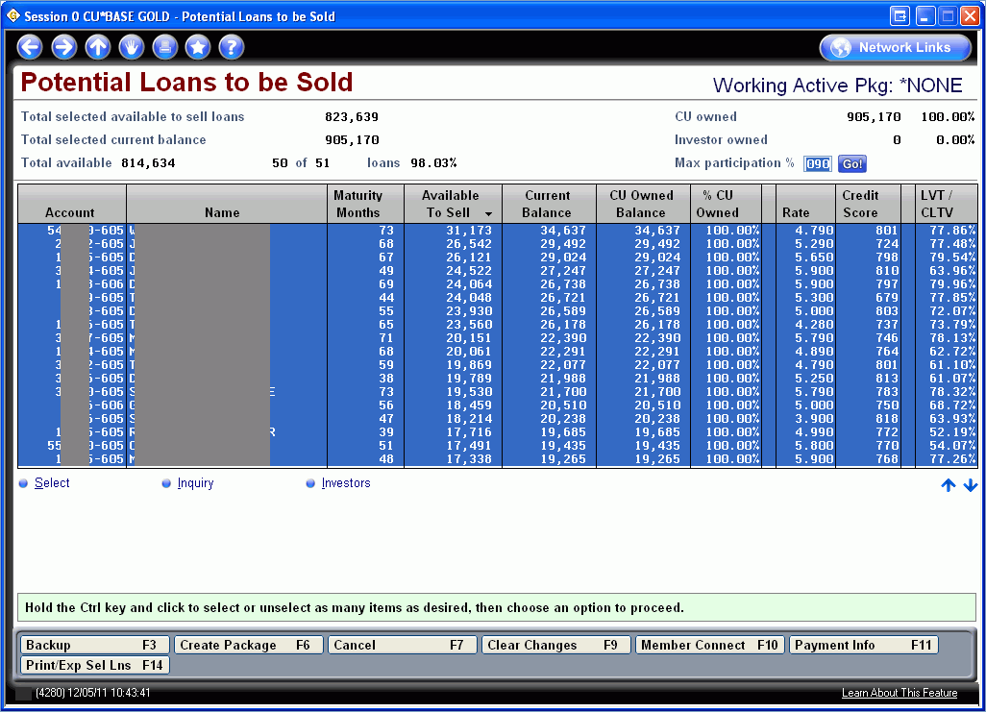

Slide 19
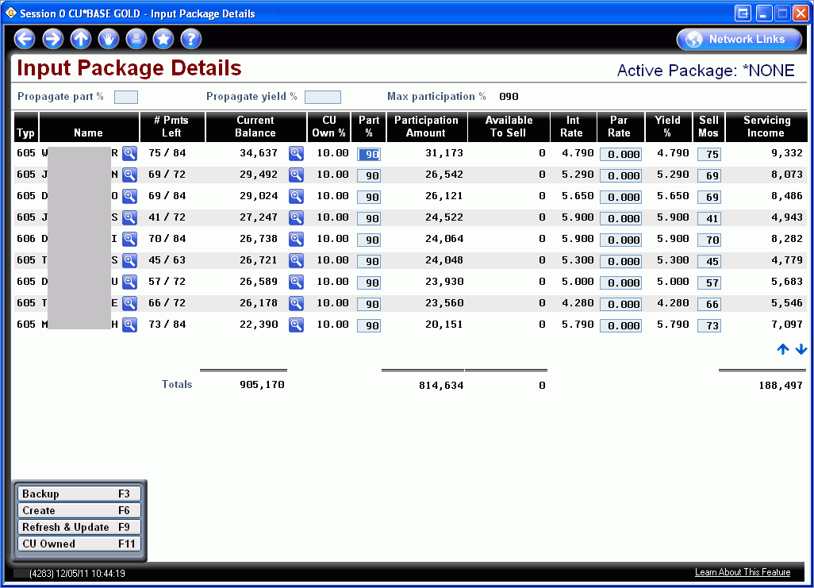

Slide 20
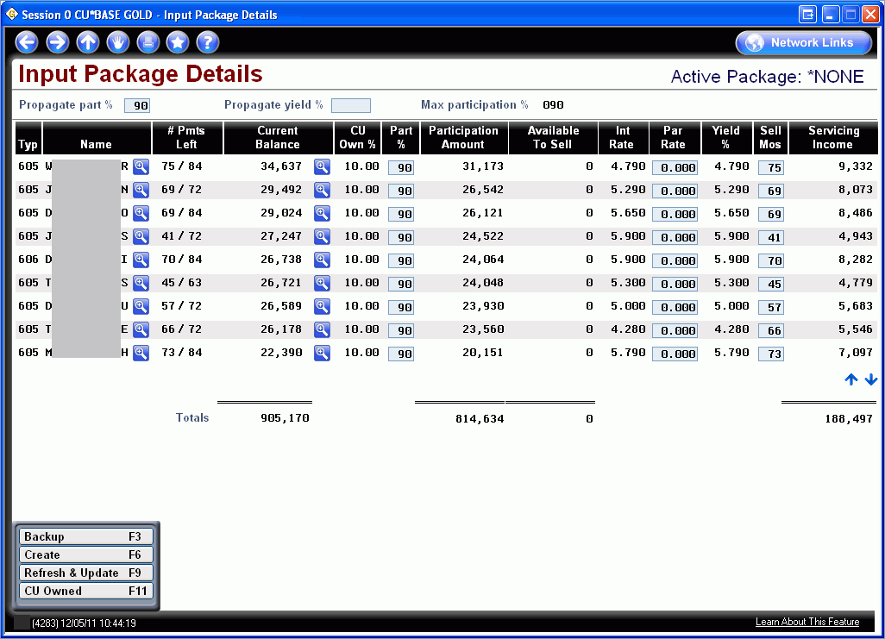

Slide 25
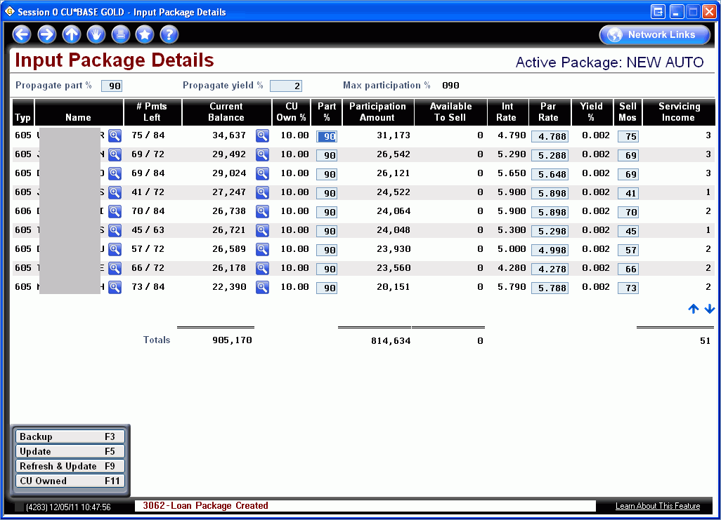

Slide 26
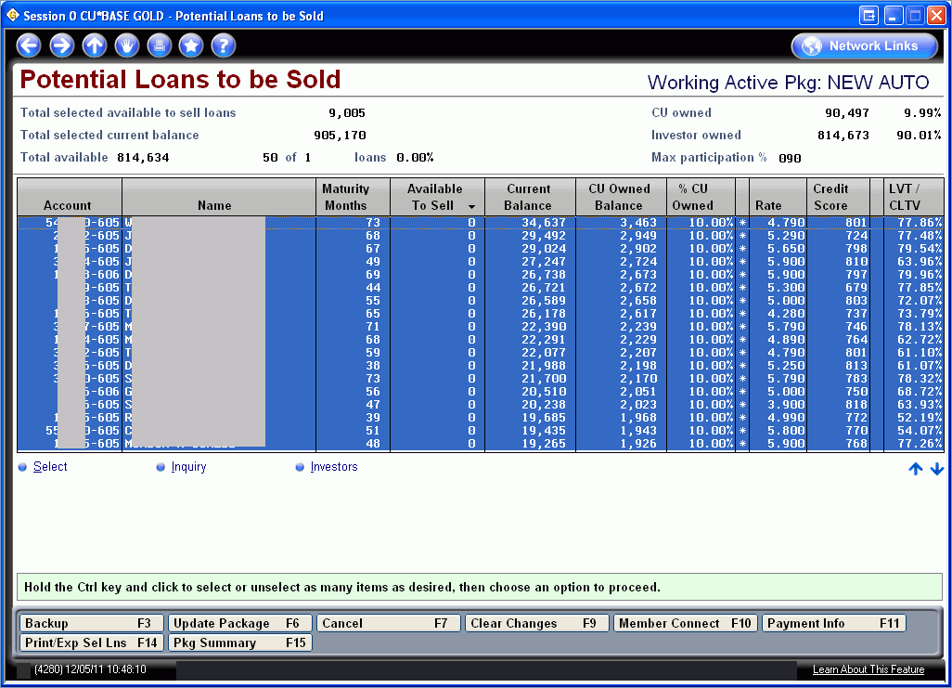

Slide 27
Medallion Collateral Type

Slide 28
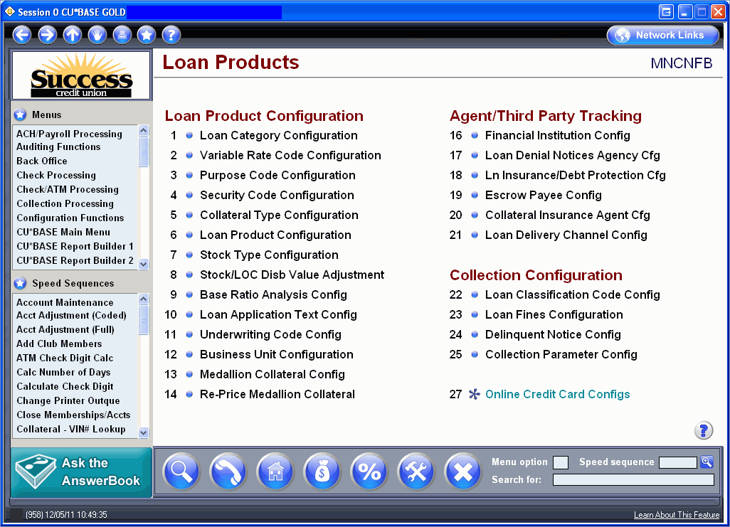

Slide 29
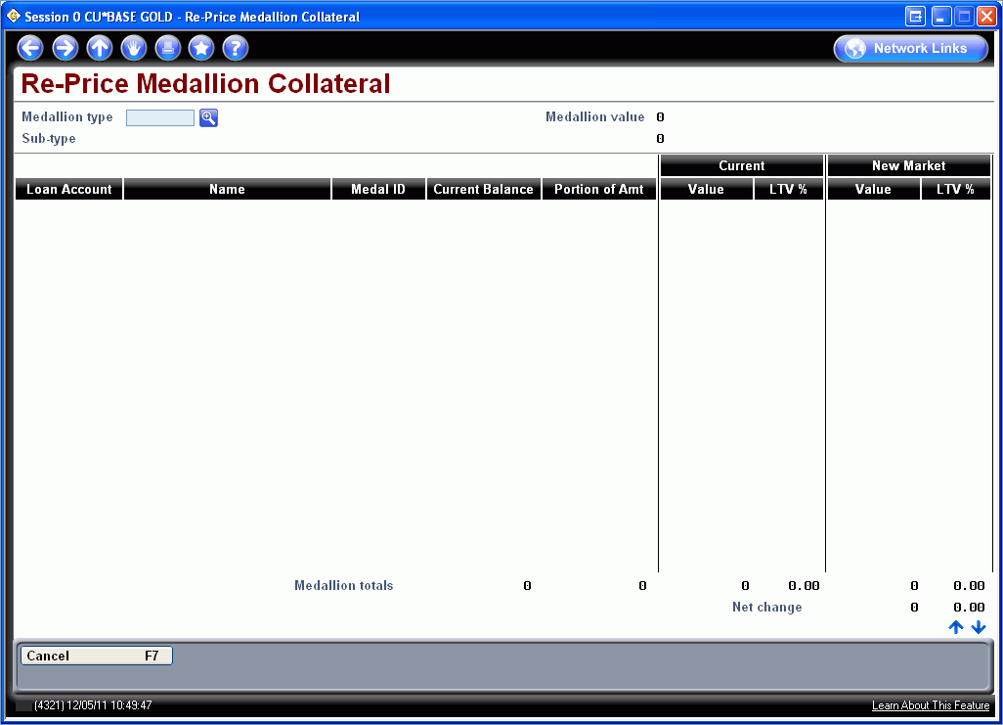

Slide 30
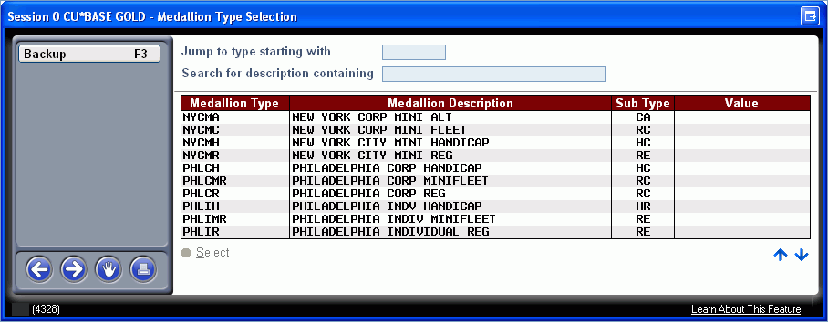

Slide 31
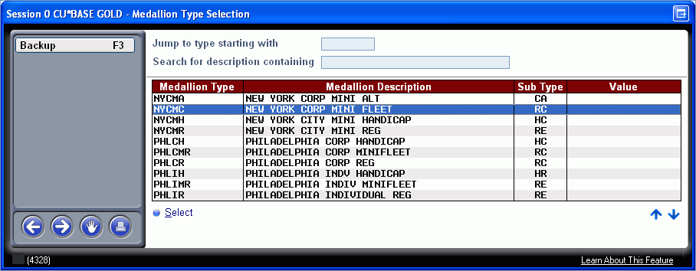

Slide 32
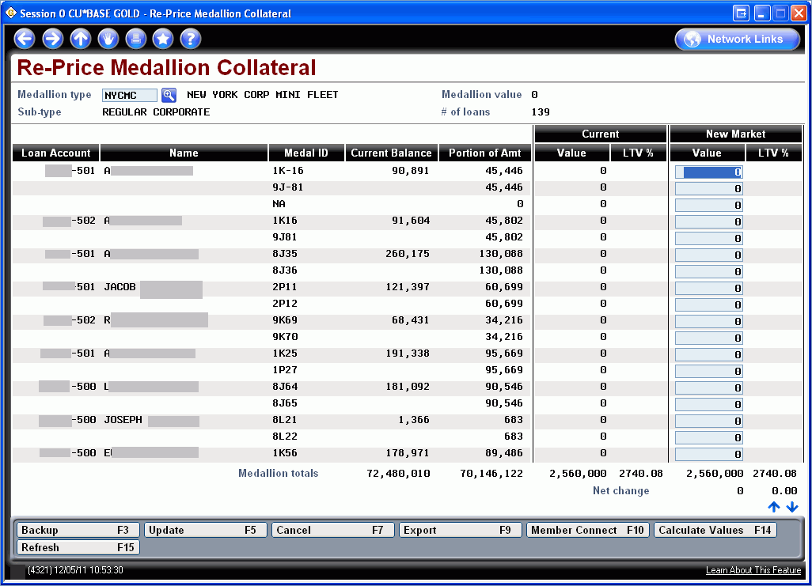

Slide 33
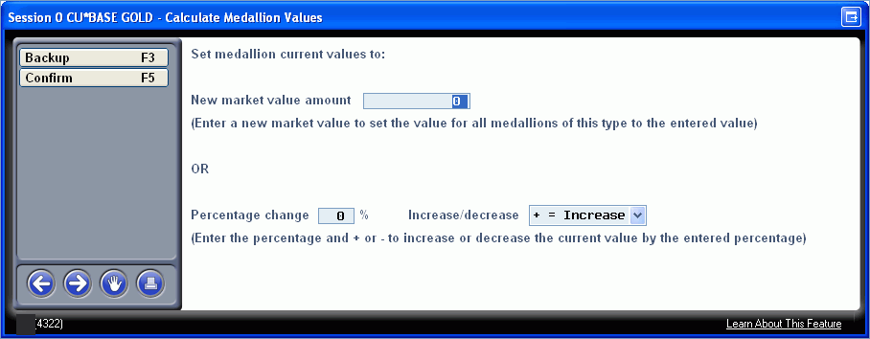

Slide 34
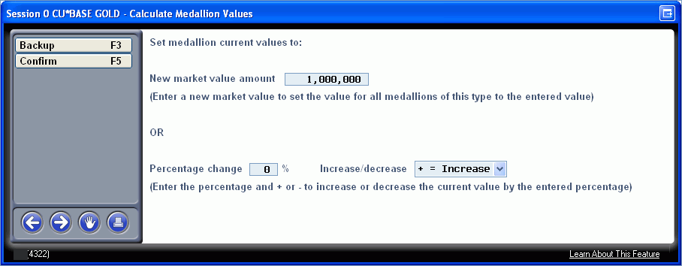

Slide 35
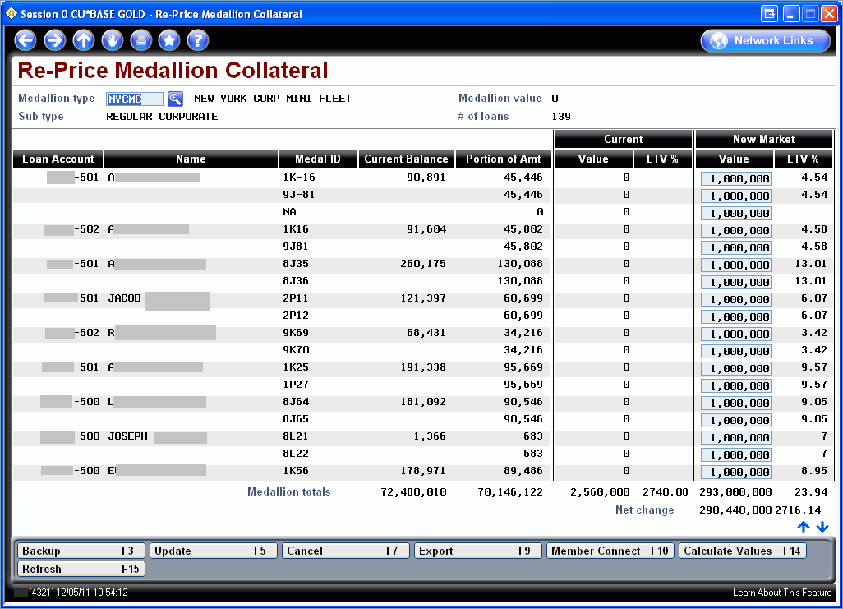

Slide 36
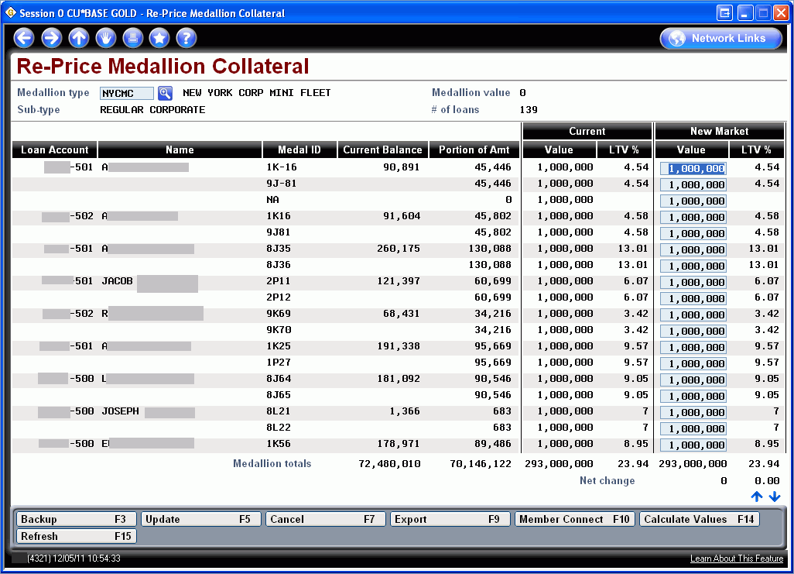

Slide 37
Participation Loan Inquiry

Slide 38
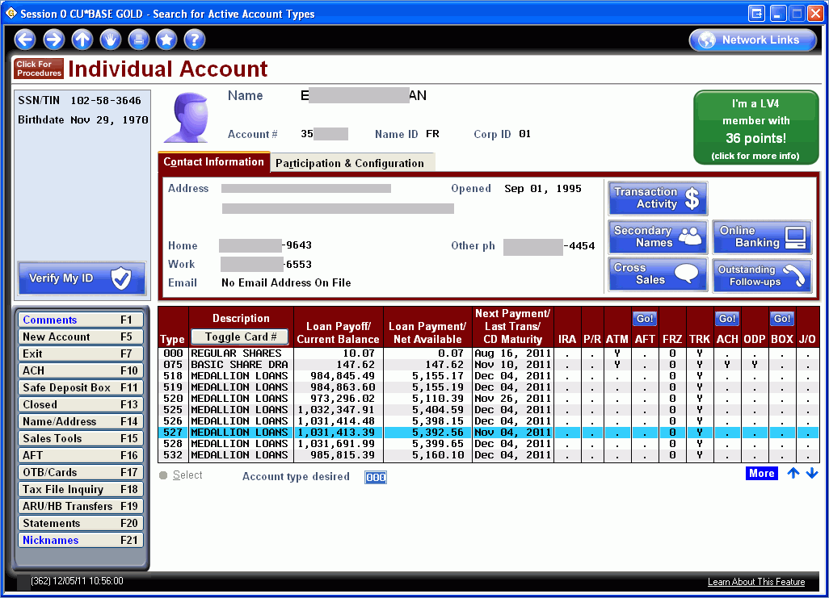

Slide 40
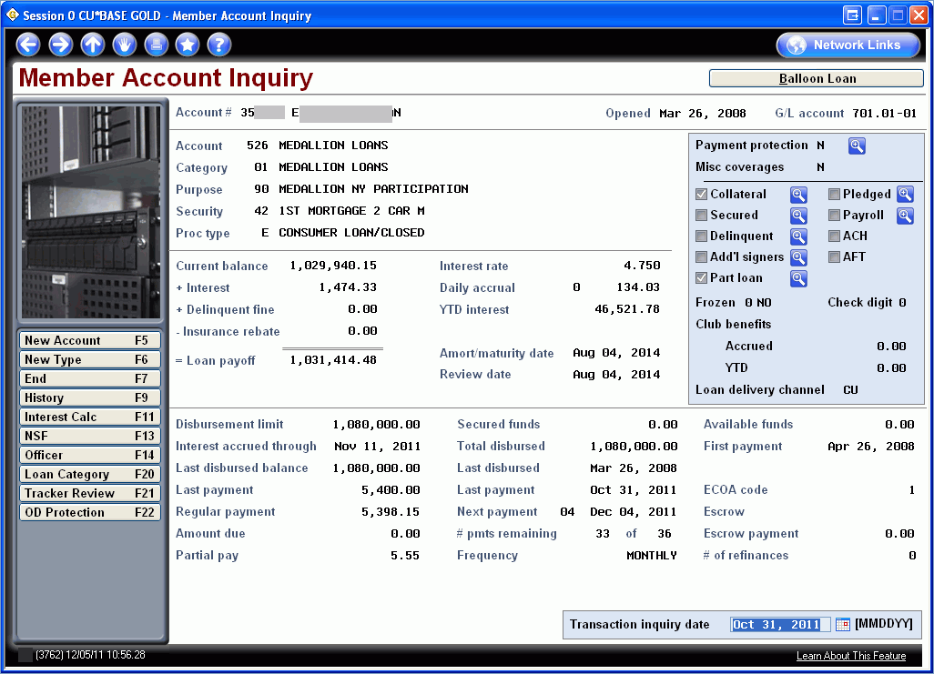

Slide 41
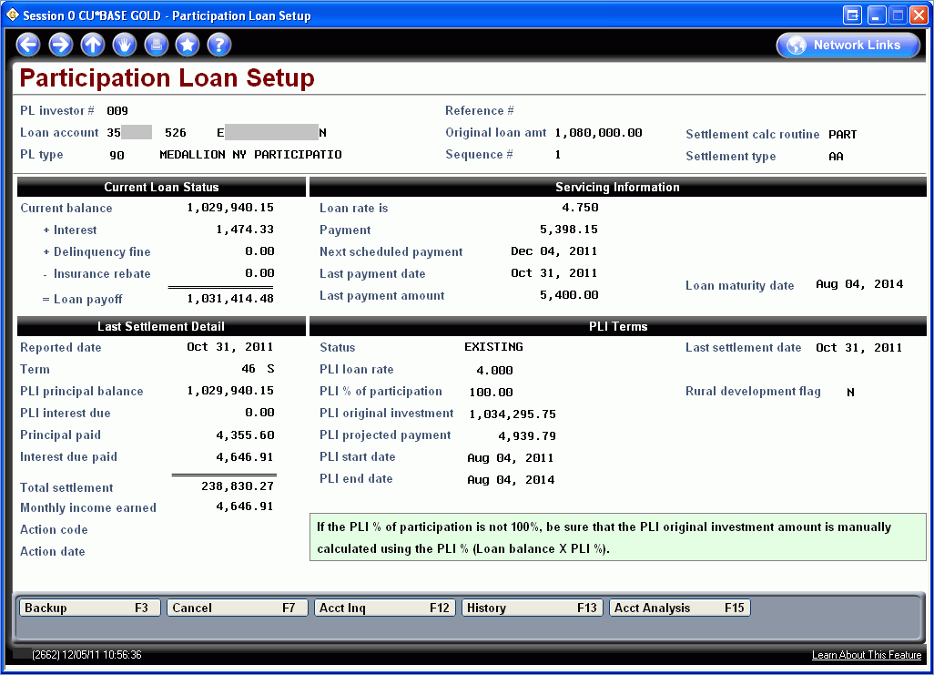

Slide 42
Collateral Enhancements

Slide 43
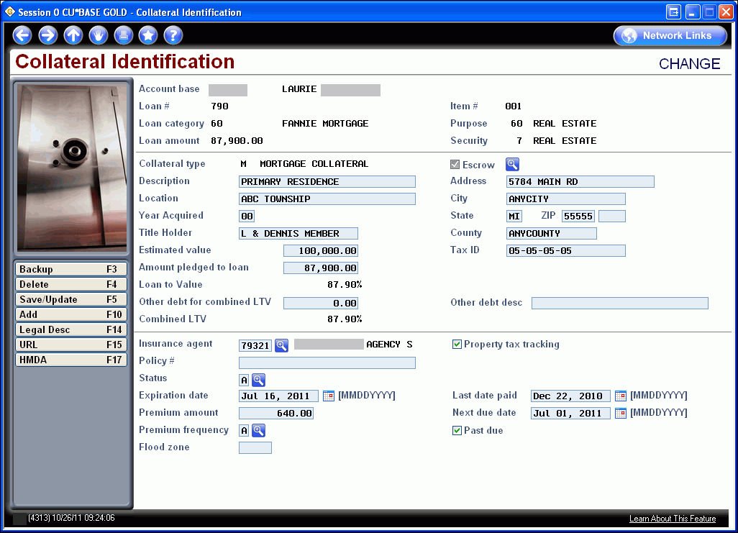

Slide 44
Adverse Action Notice

Slide 46
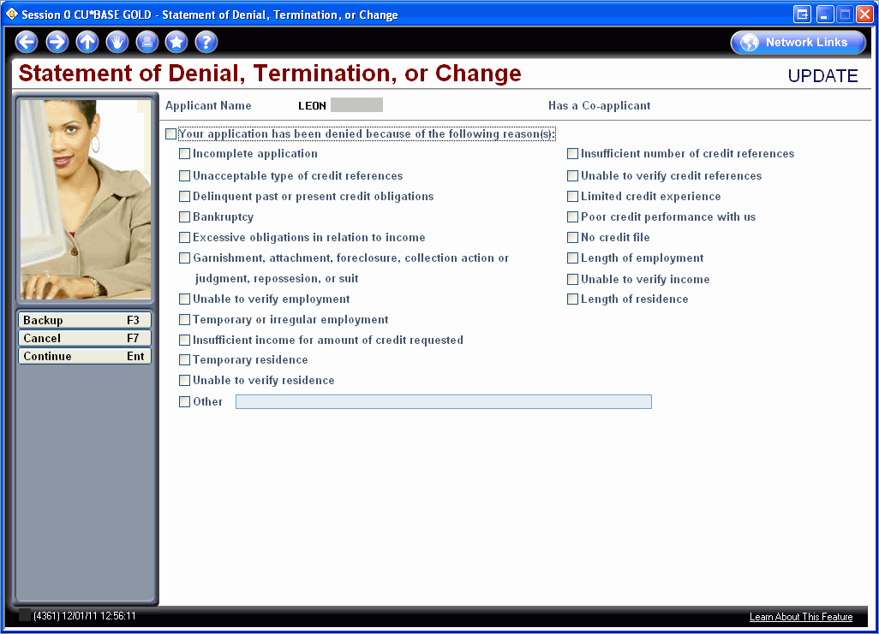

Slide 47
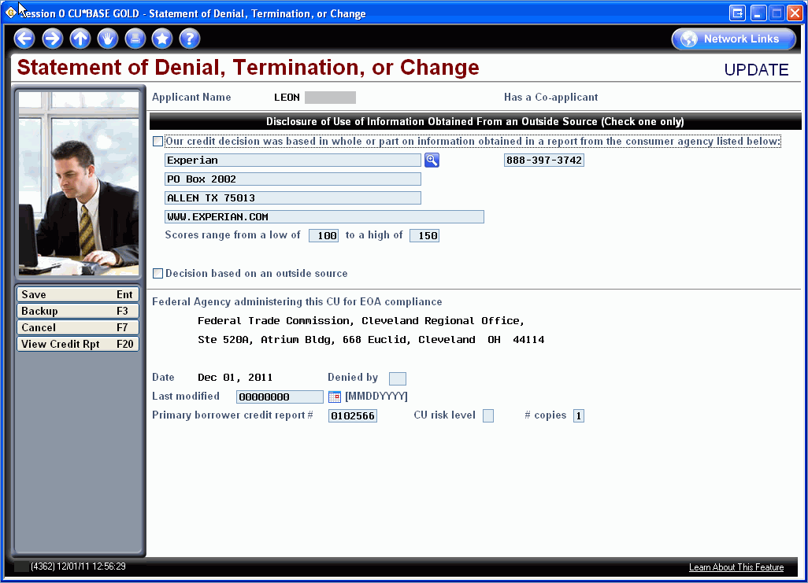

Slide 48
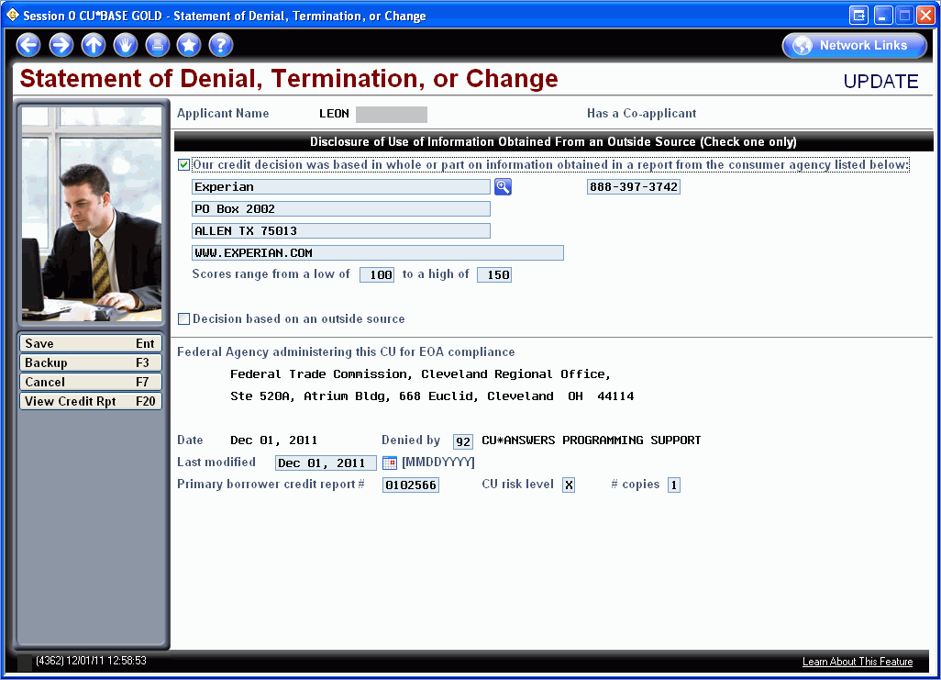

Slide 50
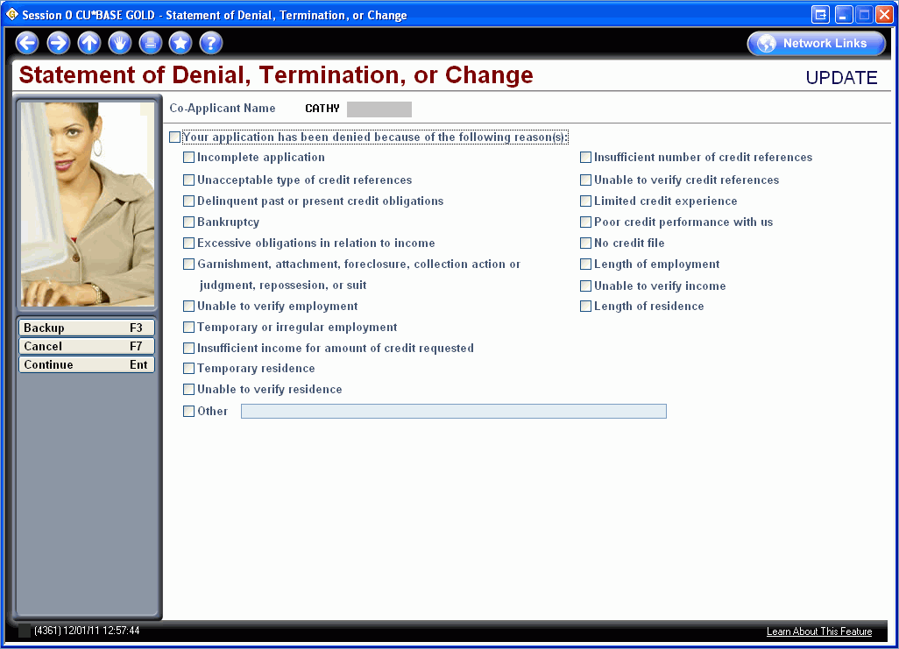

Slide 52
Credit Score History Dashboard

Slide 53
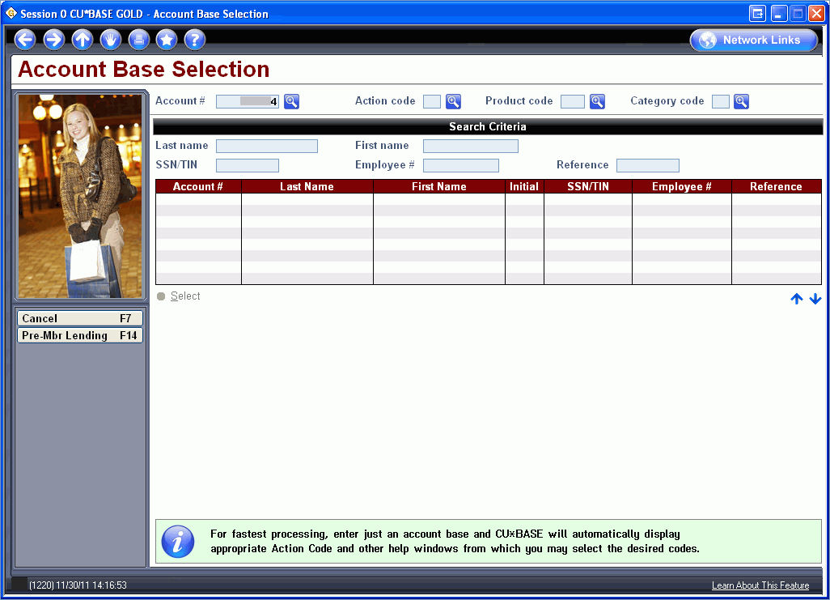
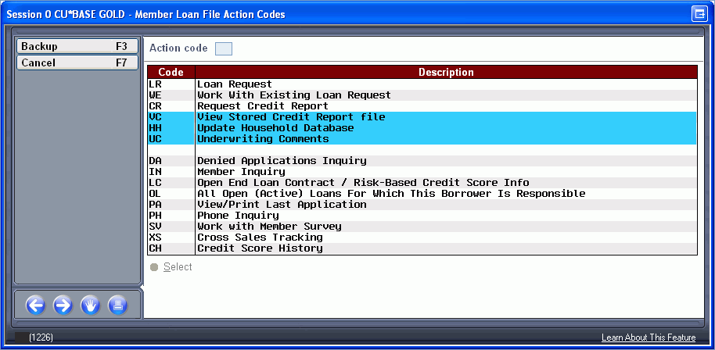

Slide 54
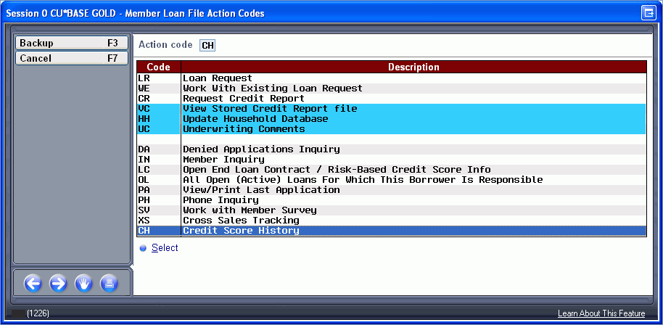

Slide 55
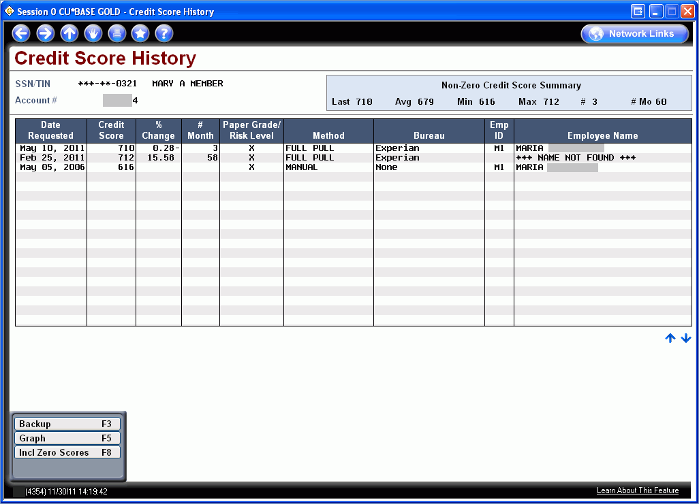

Slide 56
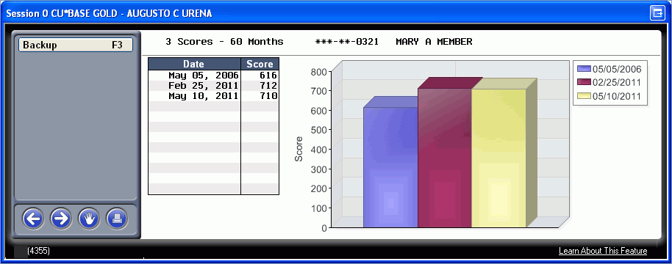

Slide 57
EasyPay Powered by iPay for Mobile Web

Slide 58
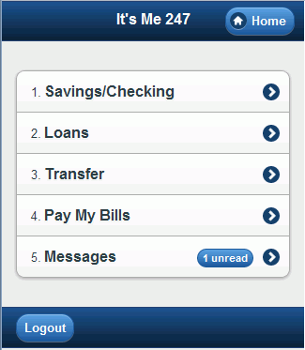
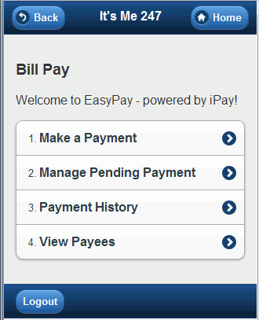

Slide 59
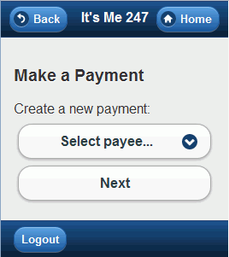
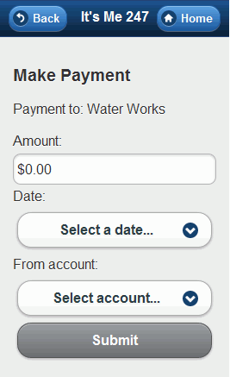

Slide 60
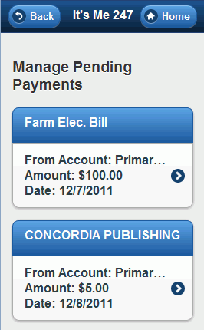
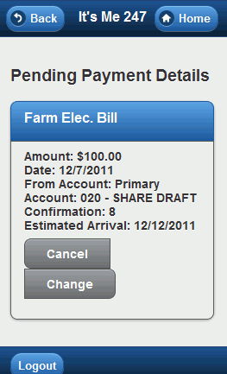

Slide 61
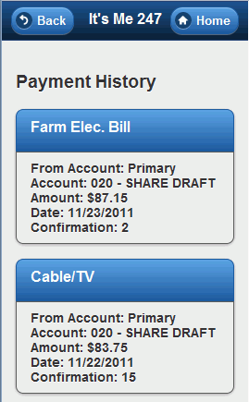
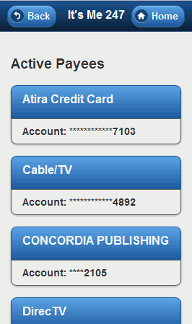

Slide 62
Batch Unenrollment for E-Statements

Slide 64
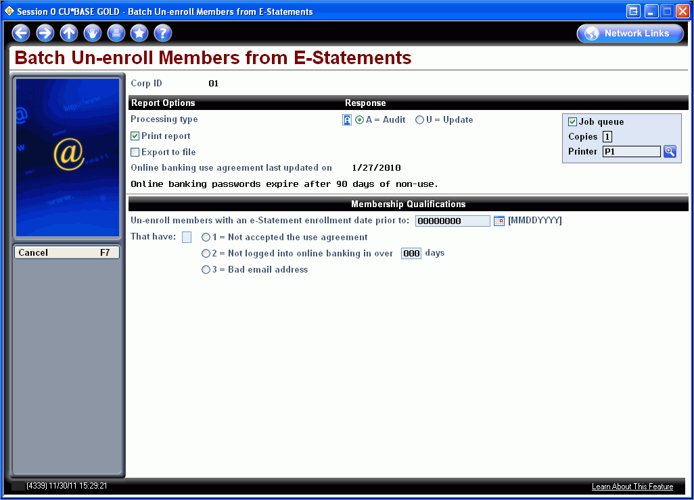

Slide 65
User ID Inquiry and History

Slide 67
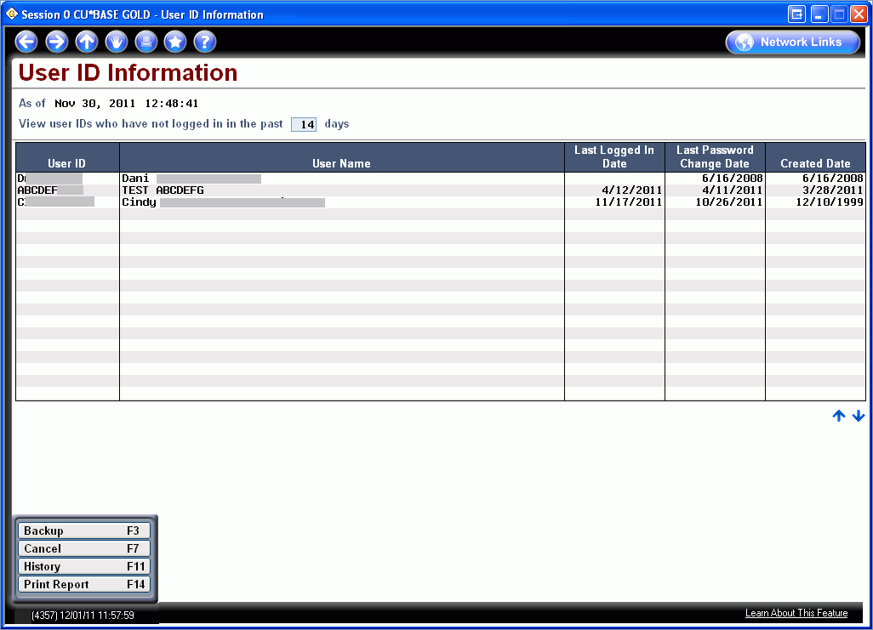

Slide 69
End of Month File Name Added to Database Inquiry Screen

Slide 70
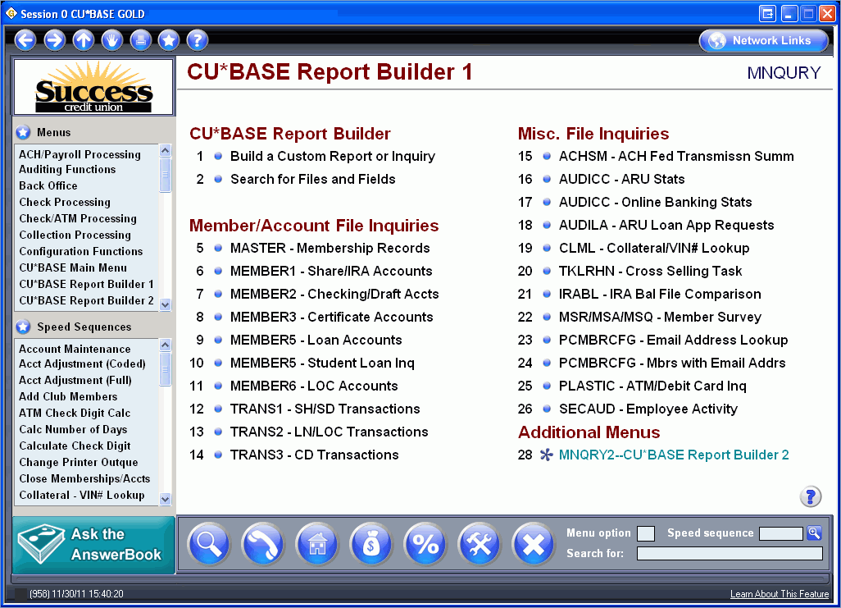

Slide 74
Learn from a Peer – CD rate Dashboard

Slide 82
MoneyDesktop

Slide 84
And More – Miscellaneous

Slide 85
How Can I share this with my staff?
How can I share this information at my credit union to further train staff?

Slide 86
Digging Deeper
Resources available
http://marketing.cuanswers.com/2011/12/05/its-me-247-text-banking-collateral/ for Mobile Text Banking collateral
http://www.cuanswers.com/client_reference.php for CU*BASE reference material
http://www.cuanswers.com/client_reference_itsme.php for It’s Me 247 reference materials
http://www.cuanswers.com/doc/gold/gold.htm for CU*BASE GOLD online help
http://www.cuanswers.com/doc/stepbystep/stepbystep.htm#welcome.htm for Show Me the Steps Help

Slide 87
Thank You for Attending!

