Slide 1
12.0 Release Training
Online Credit Unions: July 23, 2012
CU*NorthWest/CU*South: July 29, 2012
Self Processing CUs: August 12-13, 2012
Last updated 7/13/12

Slide 2
Member Services

Slide 3
My Other Accounts

Slide 4
My Other Accounts

Slide 5
My Other Accounts

Slide 6
Phone Operator Payoff Calculator – Now for 360 Mortgages Too!

Slide 7
Phone Operator Payoff Calculator – Now for 360 Mortgages Too!

Slide 8
Updated Phone Operator History Screen

Slide 9
And More Member Services…
Last Ten Accounts Feature to Member Personal Banker
Last Ten Accounts Feature Added When Printing Miscellaneous Account Forms
Allow Checks or Transfers on Dividends to Base Share
Shared Branch Check Holds

Slide 10
Lending

Slide 11
Permanent Underwriting Comments

Slide 12
Permanent Underwriting Comments

Slide 13
Expanded Loan Application Now Allows for Unlimited Income/Employment Sources

Slide 14
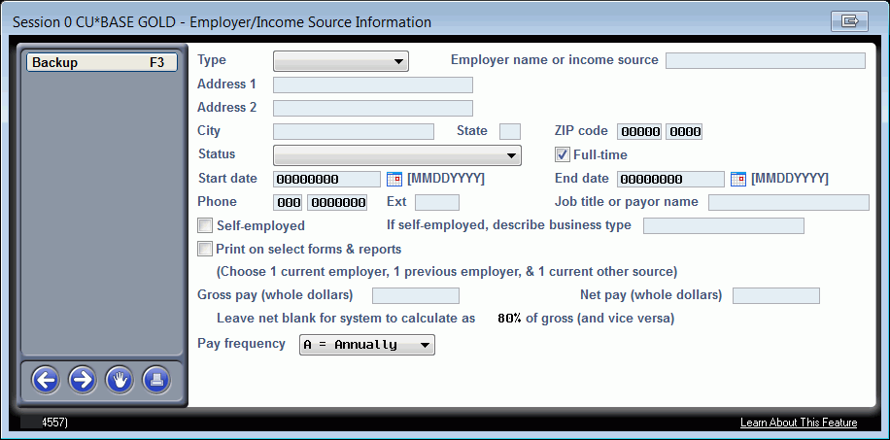
Expanded Loan Application Now Allows for Unlimited Income/Employment Sources

Slide 15
Expanded Loan Application Now Allows for Unlimited Income/Employment Sources

Slide 16
Mortgage Payoff Statements Now Available

Slide 17
And More Lending…
CPI Force-Placed Insurance
Loan Dashboard Enhancements
Participation Trial Balance Enhancements
Loan-to-Value Report Enhancements
Loan Classification Report Enhancement
Dealer Track Enhancement – Additional Terms Now Supported
Dealer Track – Collateral Other Than Auto Allowed
Allow Custom Tracker Descriptions

Slide 18
Management/CEO

Slide 19
Automating Credit Union Reports and Saving Report Filters

Slide 20
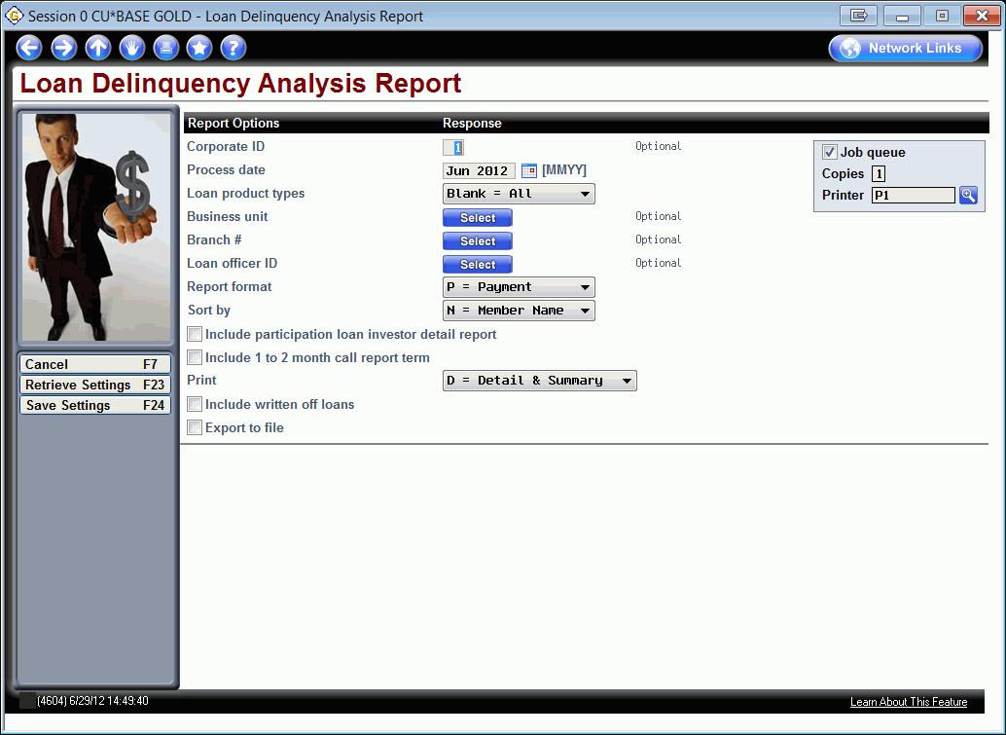
Automating Credit Union Reports and Saving Report Filters

Slide 21
Automating Credit Union Reports and Saving Report Filters

Slide 22
Automating Credit Union Queries

Slide 23
Automating Credit Union Queries

Slide 24
ANR/NSF Fee Options: Available vs. Current Balance for ATM/Debit Card Transactions

Slide 25
Concentration Risk Analysis

Slide 26
Concentration Risk Analysis

Slide 27
Mobile Web and Mobile Text Statistics Added to ARU/Online Banking Dashboard

Slide 28
Learn from a Peer – Loan Rate Comparison Dashboard

Slide 29
Learn from a Peer – Loan Rate Comparison Dashboard

Slide 30
NEW! Member Retention (by Year Opened) Dashboard

Slide 31
NEW! Account Retention (by Year Opened) Dashboard

Slide 32
Membership Retention (by Age Group) Dashboard Enhancements

Slide 33
NEW! Account Retention (by Member Age Group) Dashboard

Slide 34
Transaction Sampling Dashboard

Slide 35
Tiered Services Analysis Dashboard Enhancements

Slide 36
Tiered Services Analysis Dashboard Enhancements

Slide 37
And More Management/CEO…
ATM Activity Dashboard
New YTD Dividends Interest Report
Access Data on Months Prior to the Previous End-of-Month – Without a Backup Tape!

Slide 38
Marketing

Slide 39
Smart Messaging

Slide 40
Smart Messaging

Slide 41
Updated Inquiry to Review Enrolled/Suspended Marketing Club Members

Slide 42
Auditing

Slide 43
Abnormal Activity Monitoring

Slide 44
Watch for Abnormal Activity – From Phone Operator, Inquiry and Verify Member

Slide 45
And More Auditing…
OFAC Scan Now Archived to OUTQ
New Data Center Security Reports
Branch Indicator Added to BSA Report

Slide 46
Accounting/Back Office
New Method for Upload – Direct Mail Post and G/L Import
Duplicate Item Detection
“No ANR Notice Printed” Option for Courtesy Pay Notices
Enhanced Tax Maintenance Screens
For Self Processors: Select 1 or 2 Backup Tapes

Slide 47
EFT
ATM Hold Maintenance

Slide 48
Questions?
How can I share this information at my credit union to further train staff?

Slide 49
Digging Deeper
Resources available
http://www.cuanswers.com/client_release_summaries.php for the Release Summary
http://www.cuanswers.com/client_reference.php for CU*BASE reference materials
http://www.cuanswers.com/client_reference_itsme.php for It’s Me 247 reference materials
http://www.cuanswers.com/doc/gold/gold.htm for CU*BASE GOLD online help
http://www.cuanswers.com/doc/stepbystep/stepbystep.htm#welcome.htm for Show Me the Steps Help

Slide 50
Thank you for attending!

